Slide 1
Excel Advanced
Session 2

Slide 2
Contents
Logical Functions
Conditional Functions
Cell Formatting
Advanced page setup and print options
Filter, Sort, find and replace, freezing

Slide 3
Logical Functions
IF
AND
OR
IFS
nested IF
NOT

Slide 4

IF Function
IF(B2>50,”Pass”,”Fail”)

Slide 5

IFs Function
IFS(A2>89,"A",A2>79,"B",A2>69,"C",A2>59,"D",TRUE,"F")

Slide 6
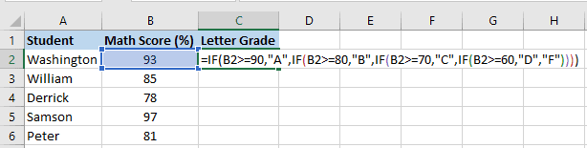
Nested IF

Slide 7
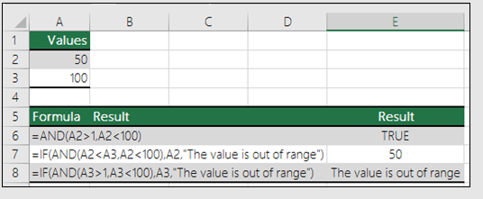
AND Function

Slide 8
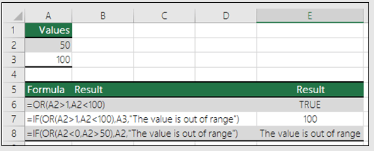
OR Function

Slide 9
Conditional Functions
SUMIF
SUMIFS
COUNTIF
COUNTIFS
AVERAGEIF

Slide 10
SUMIF
Numeric Criteria
Text Criteria
Date Criteria
And Criteria
Or Criteria

Slide 11
Cell Formatting
Alignment
Number
Cells

Slide 12

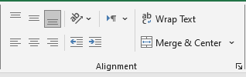
Alignment

Slide 13
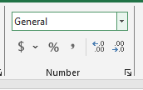
Number

Slide 14
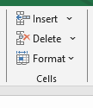
Cells

Slide 15
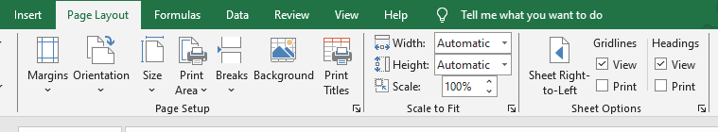
Page Setup & Print Options

Slide 16

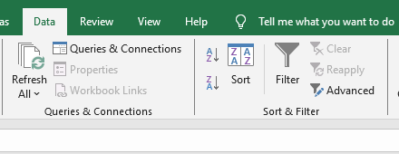
Filter & Sort

Slide 17
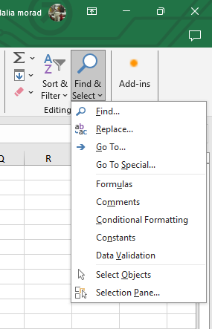
Find & Replace

Slide 18
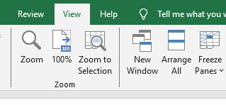
Freezing

Slide 19
Thank you
Brain Station
Eng. Dalia Khamiss

